Slide 1
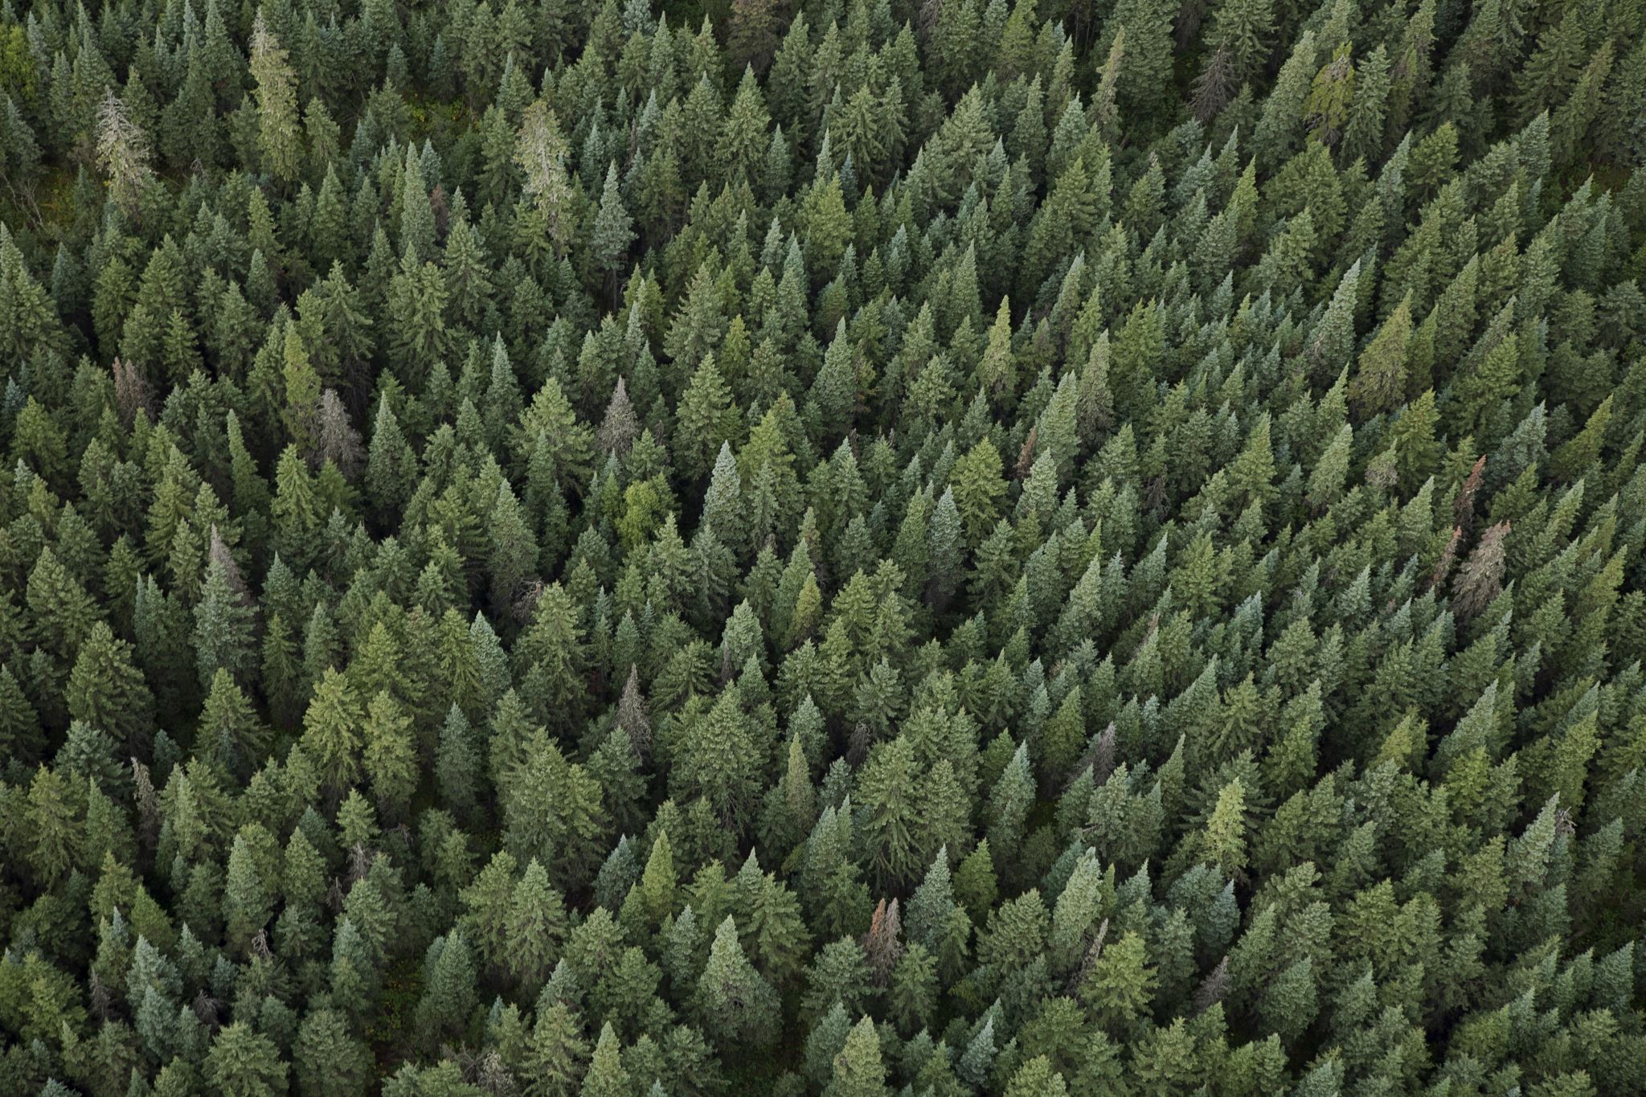
Environmental Damage
Our Planet Our Responsibility

Slide 2
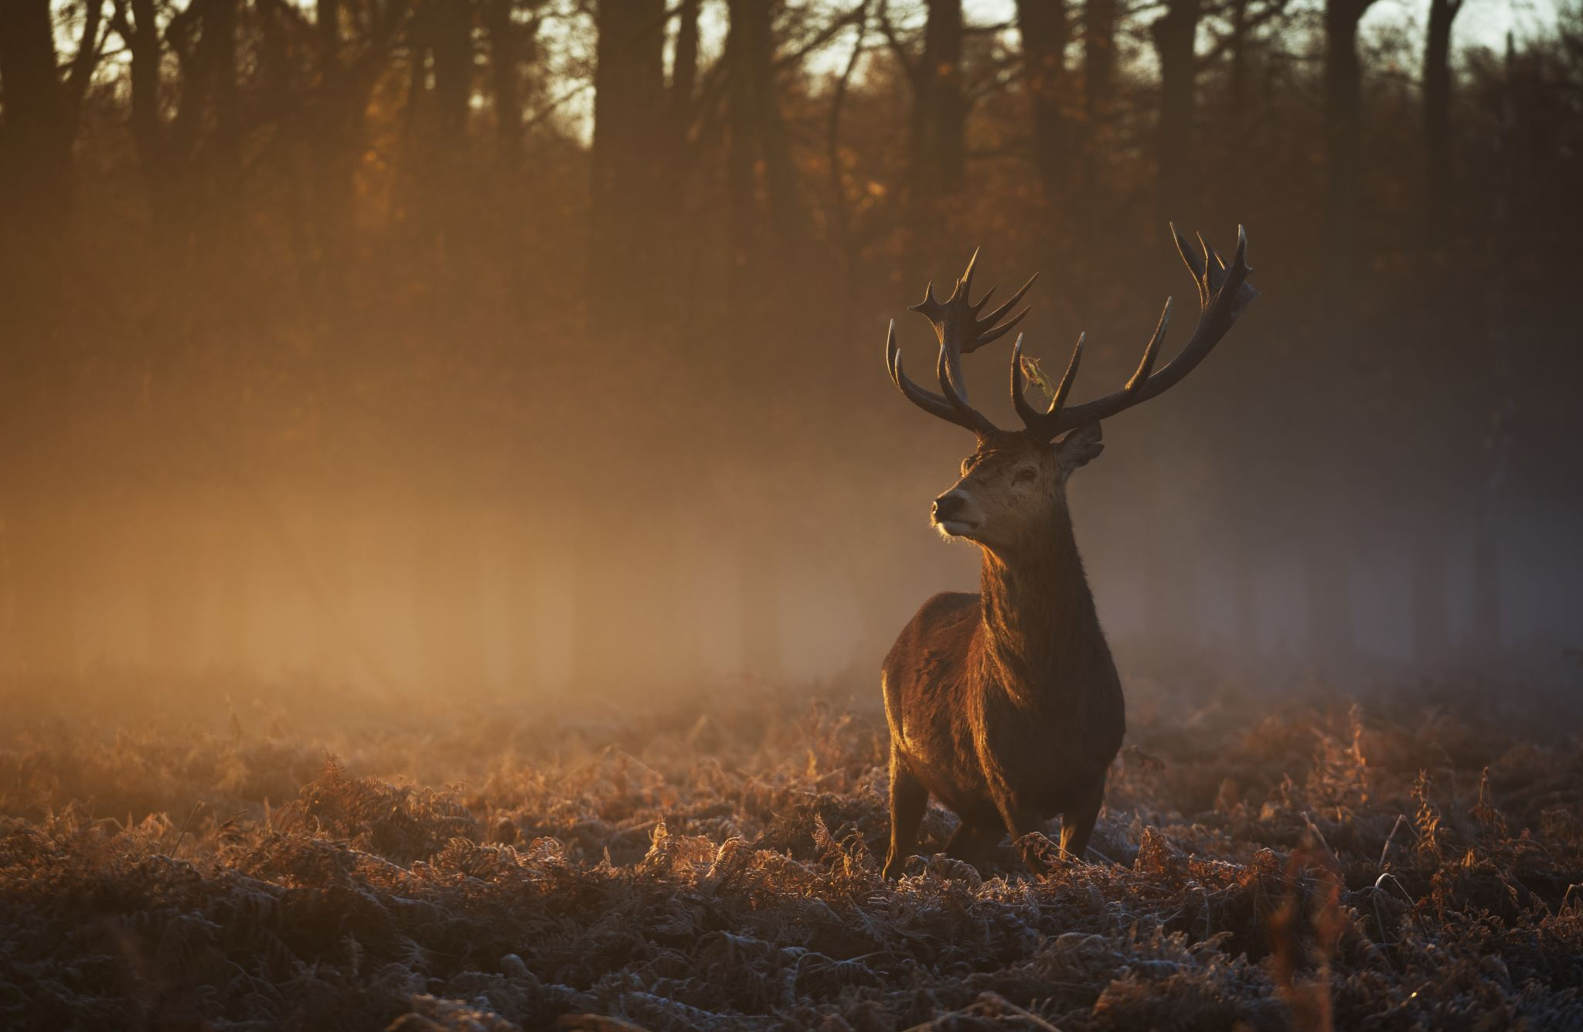
Campaign Concept
The point of this campaign is to raise awareness of environmental damage and inspire people to do little things to help our planet together
I chose this topic as it is something that means a lot to me as I feel great sympathy to the animals and life that suffers

Slide 3
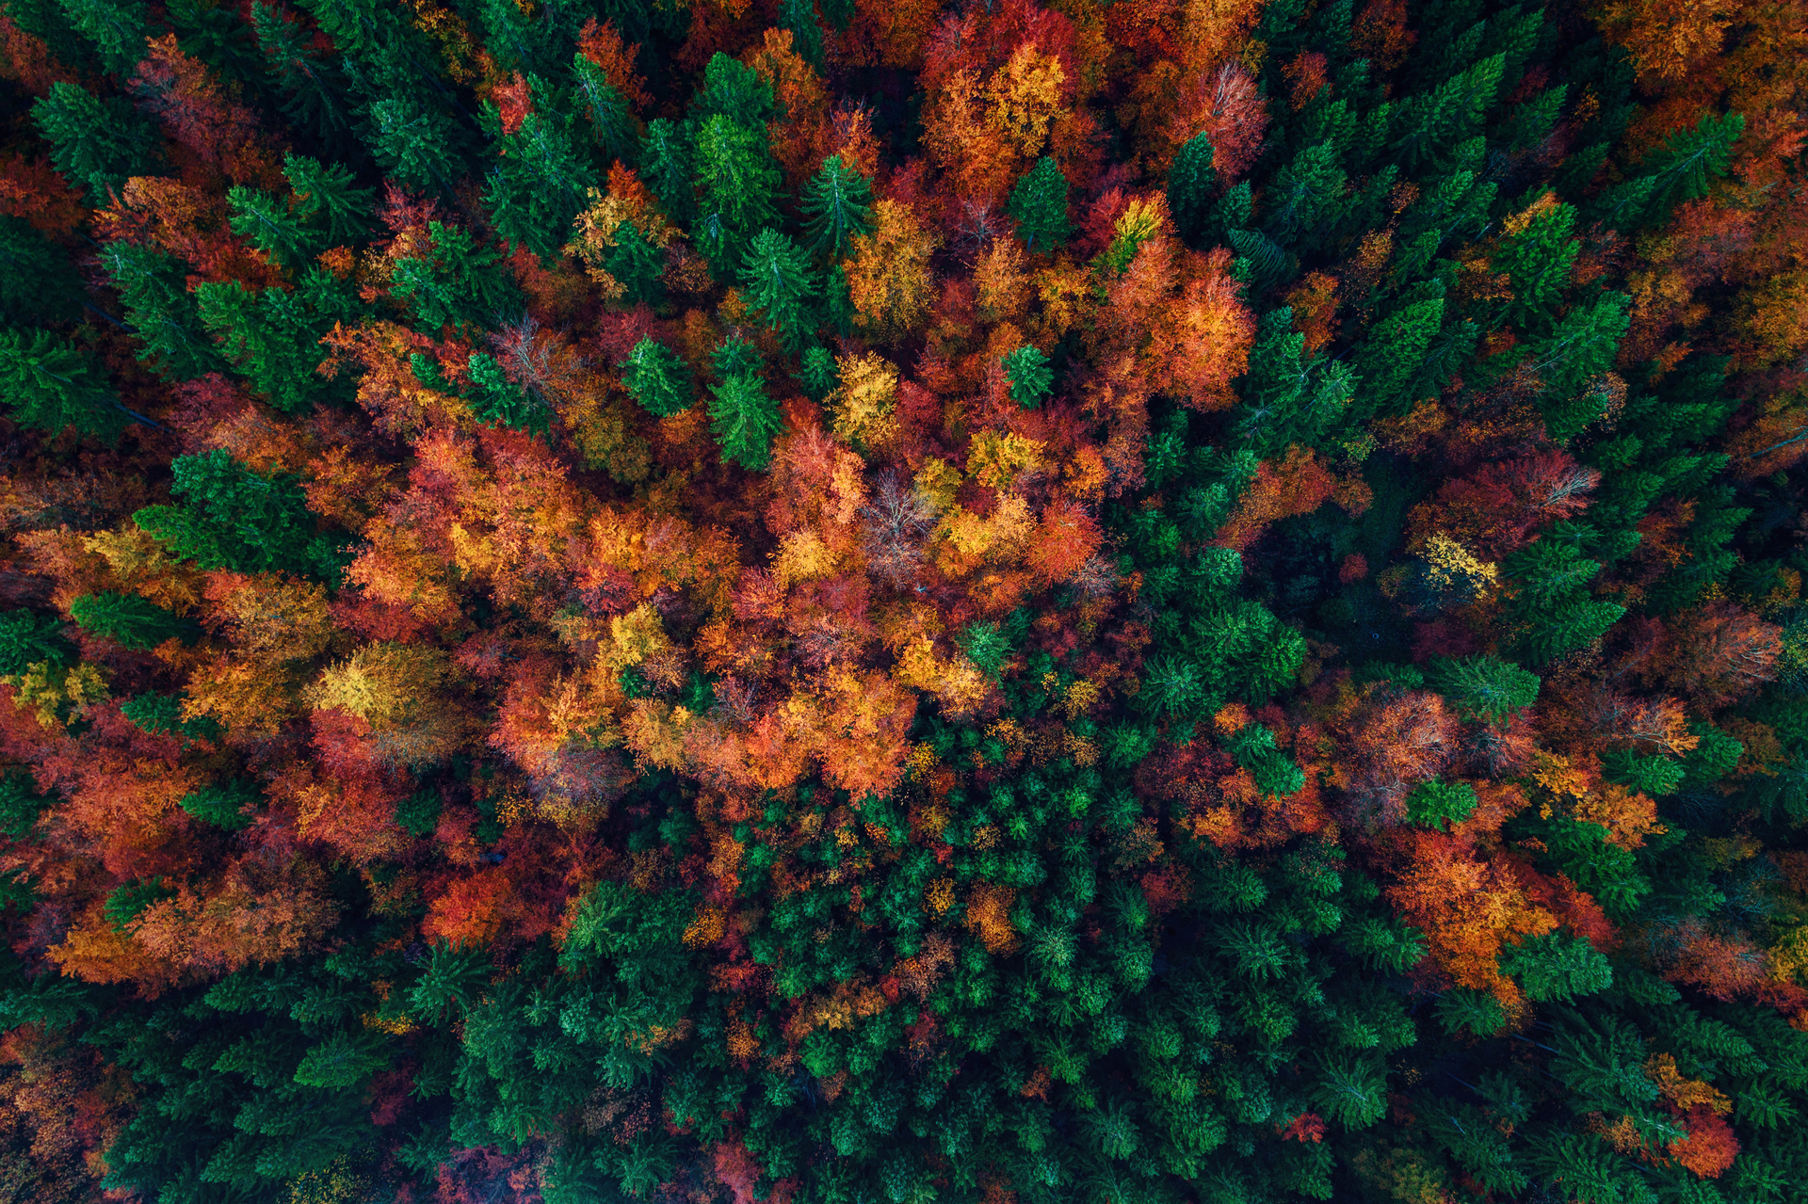
Objectives
I want to raise awareness to the audience and inspire action of small deeds.
I am also going to show contrast between nature and industrialization
But most importantly I want to create emotion and make the audience feel responsible
Raise awareness
Inspire action
Show contrast
Promote responsibility
Create an emotional connection

Slide 4
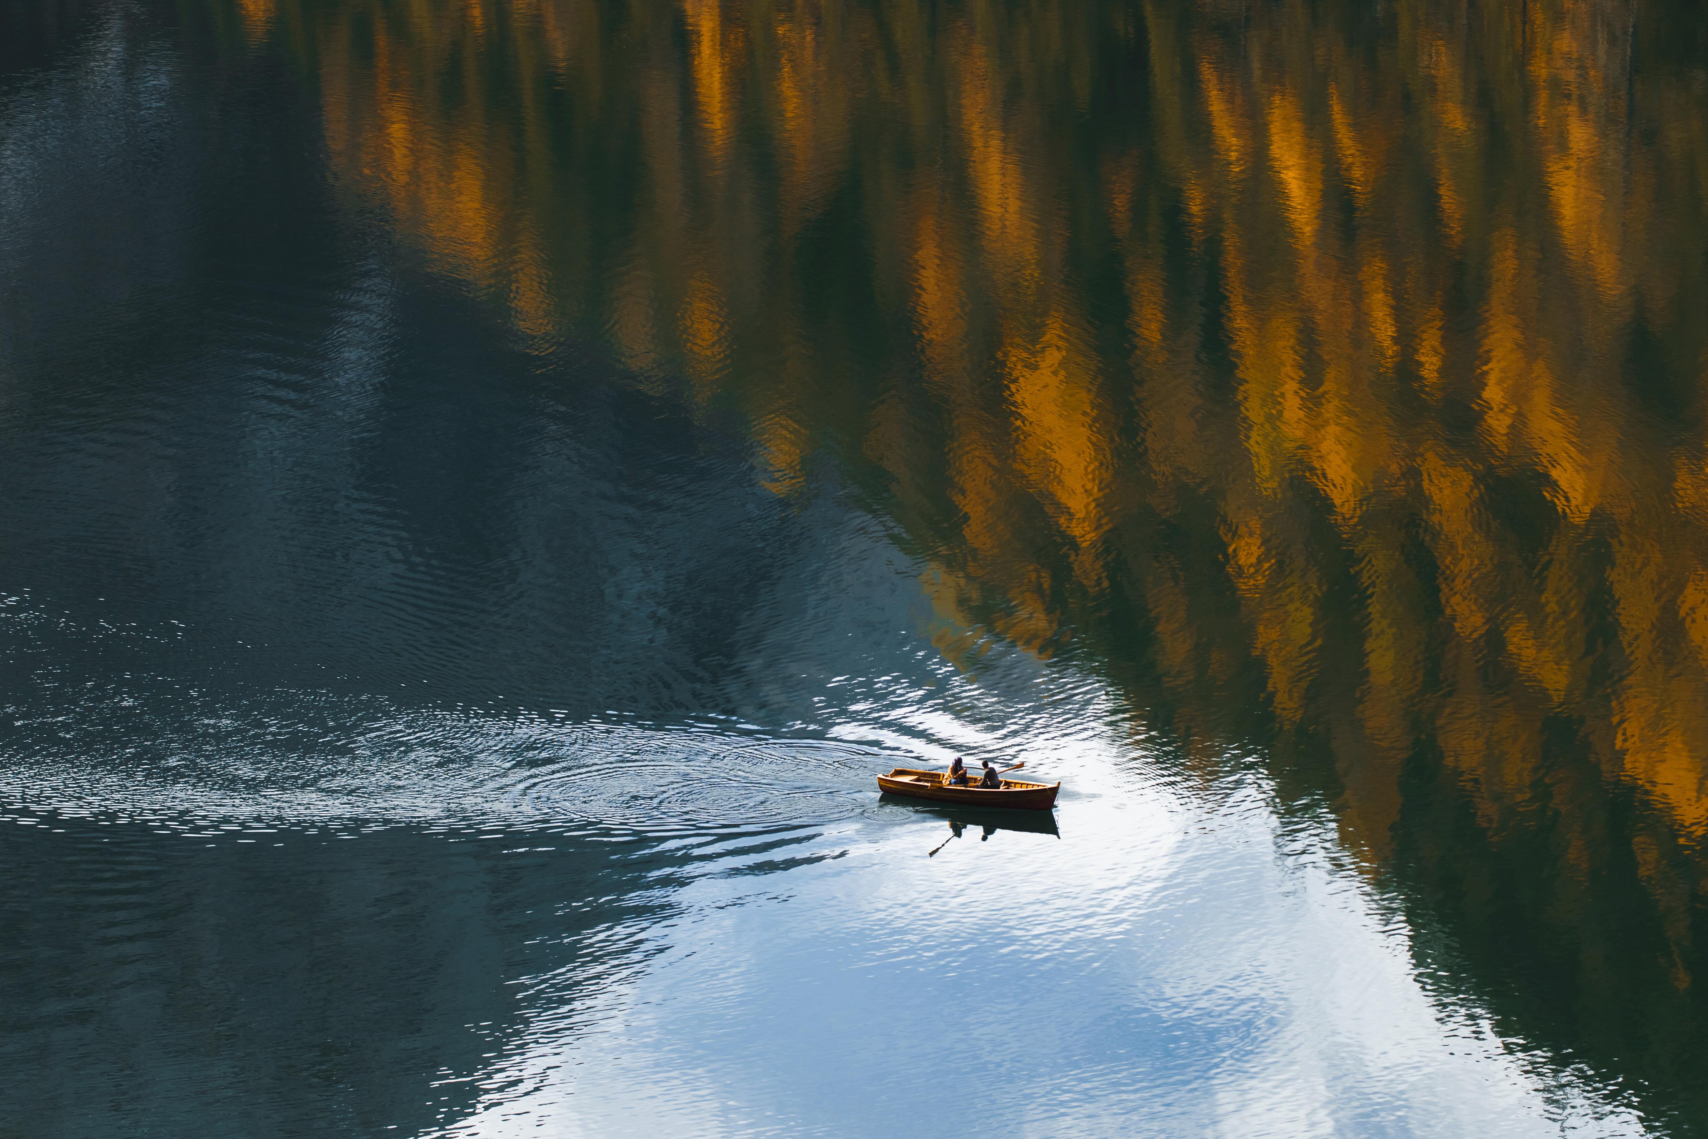
Target Audience
The reason why my primary audience is people aged 16 – 25 is because we are the next generation and our perspective on this will decide our planets future
Primary - Young people aged 16 – 25
Secondary – Local community and families

Slide 5
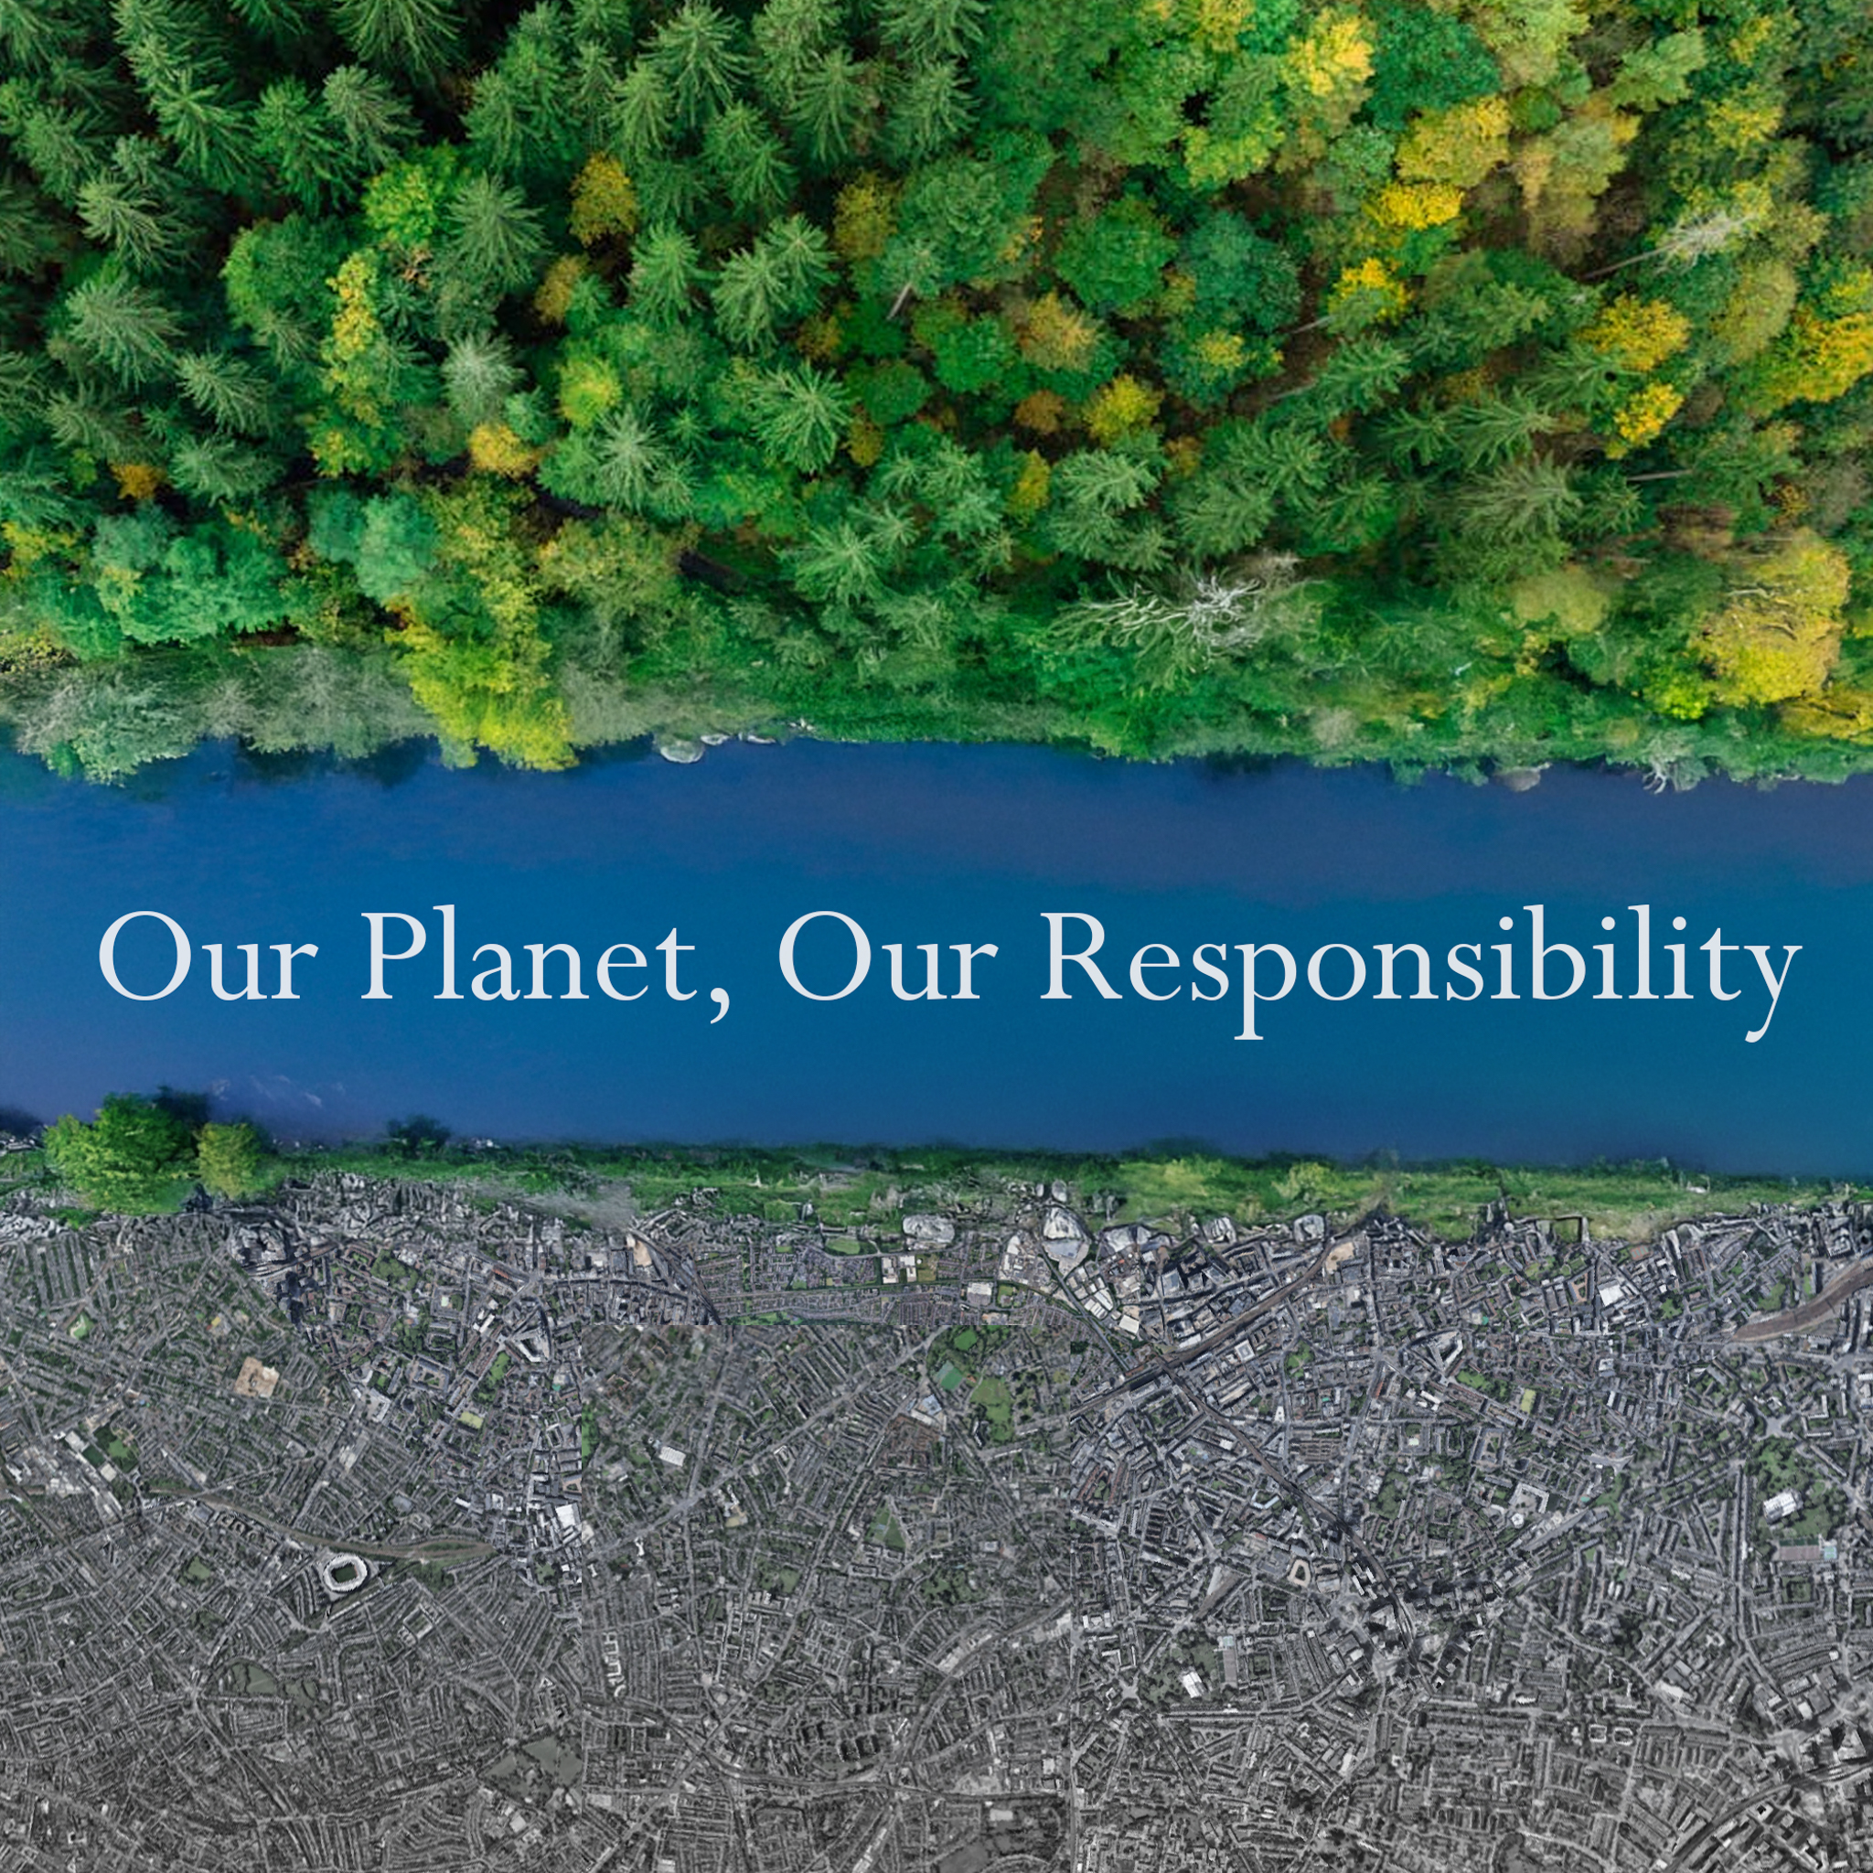
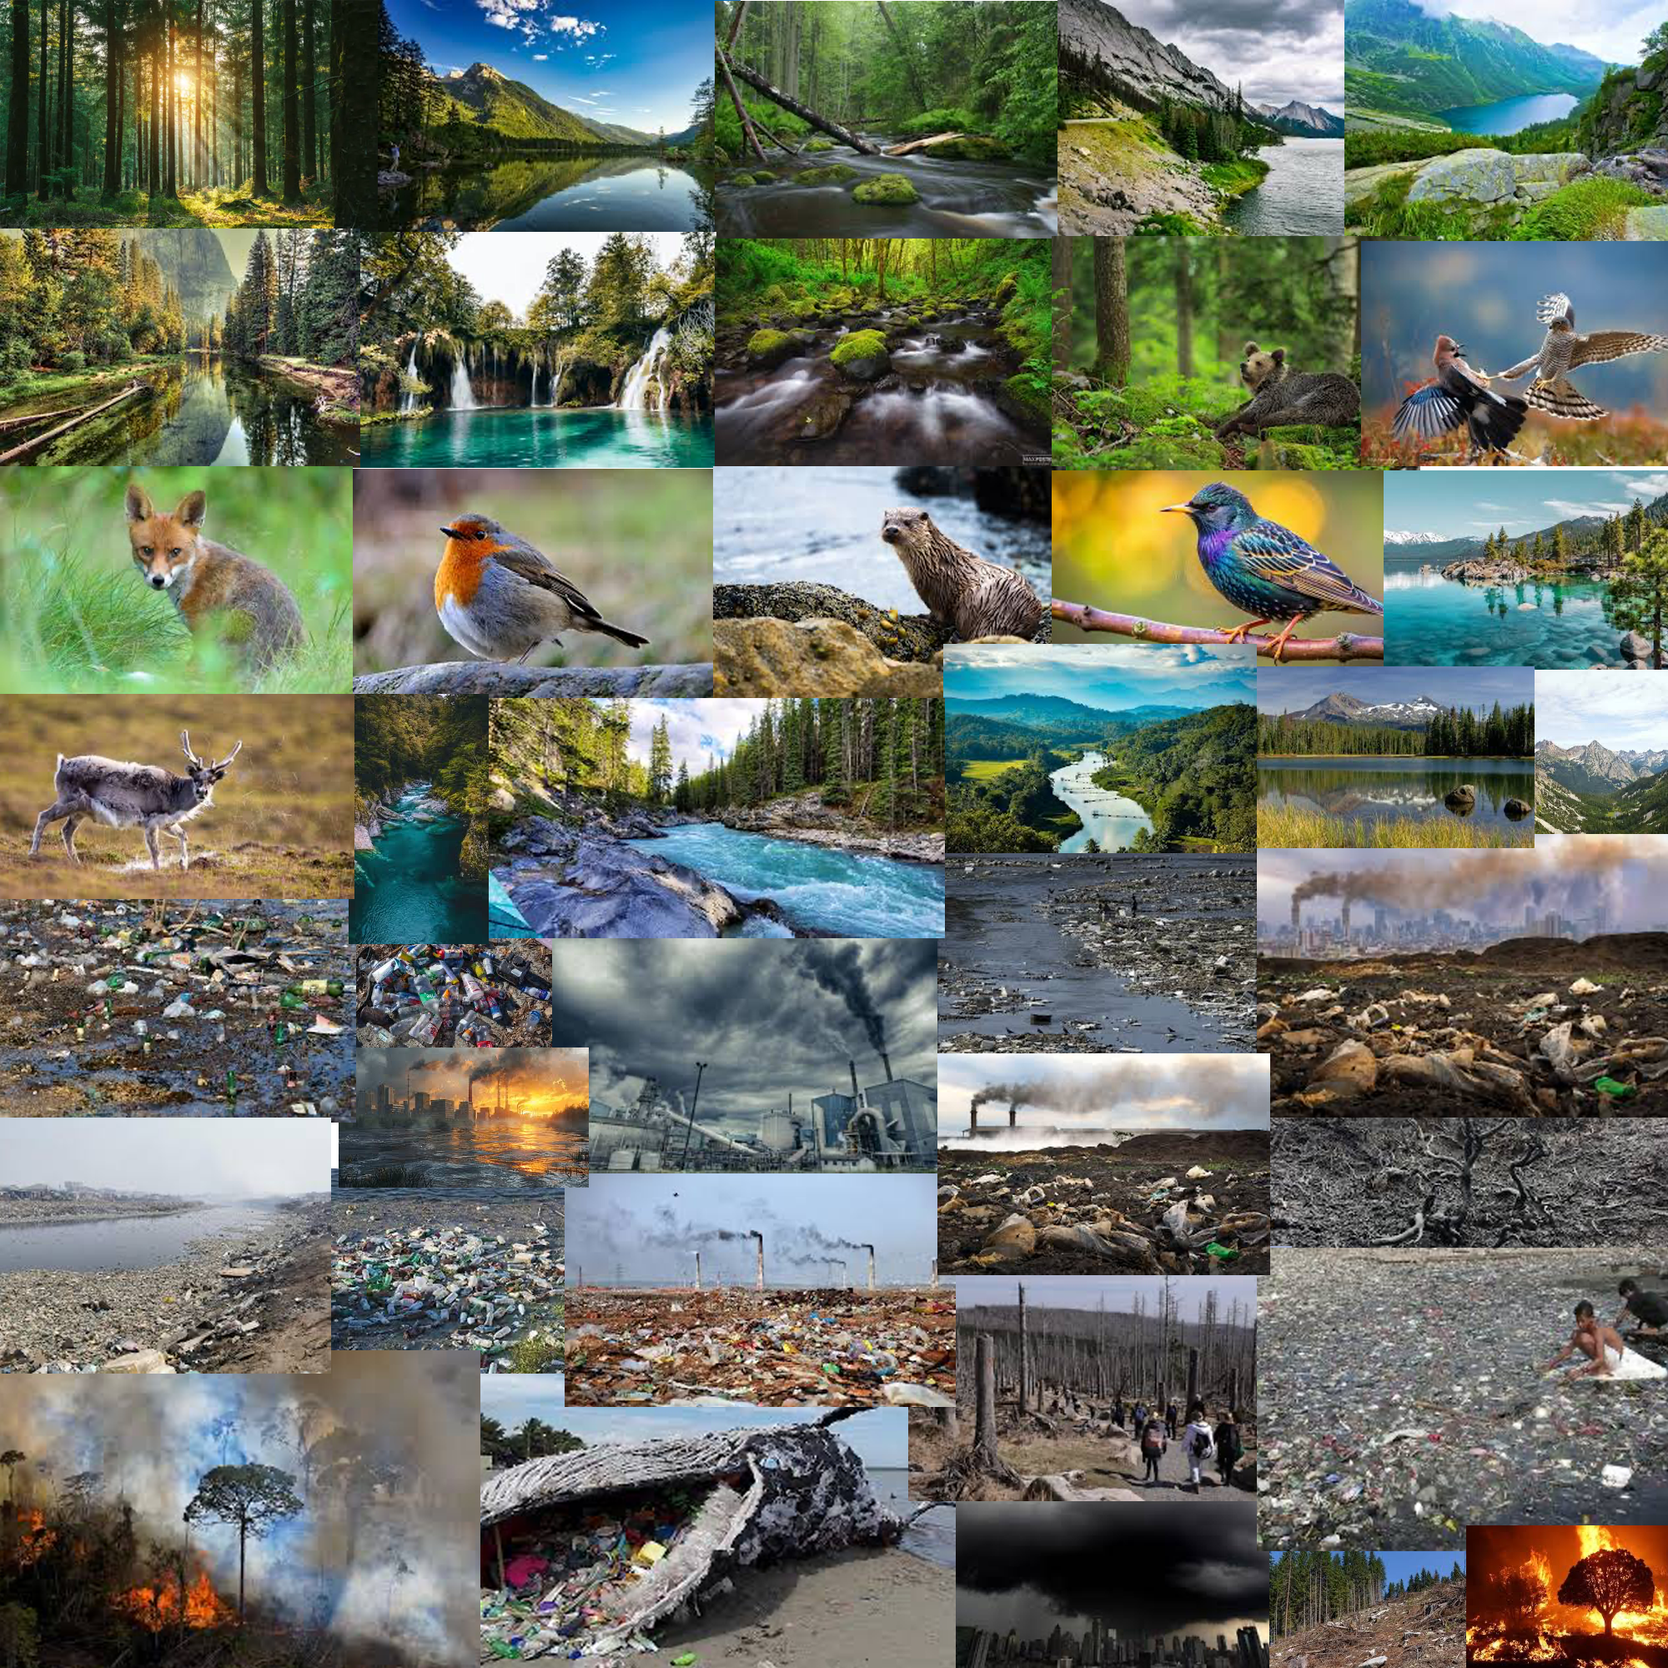
My Mood Board

Slide 6
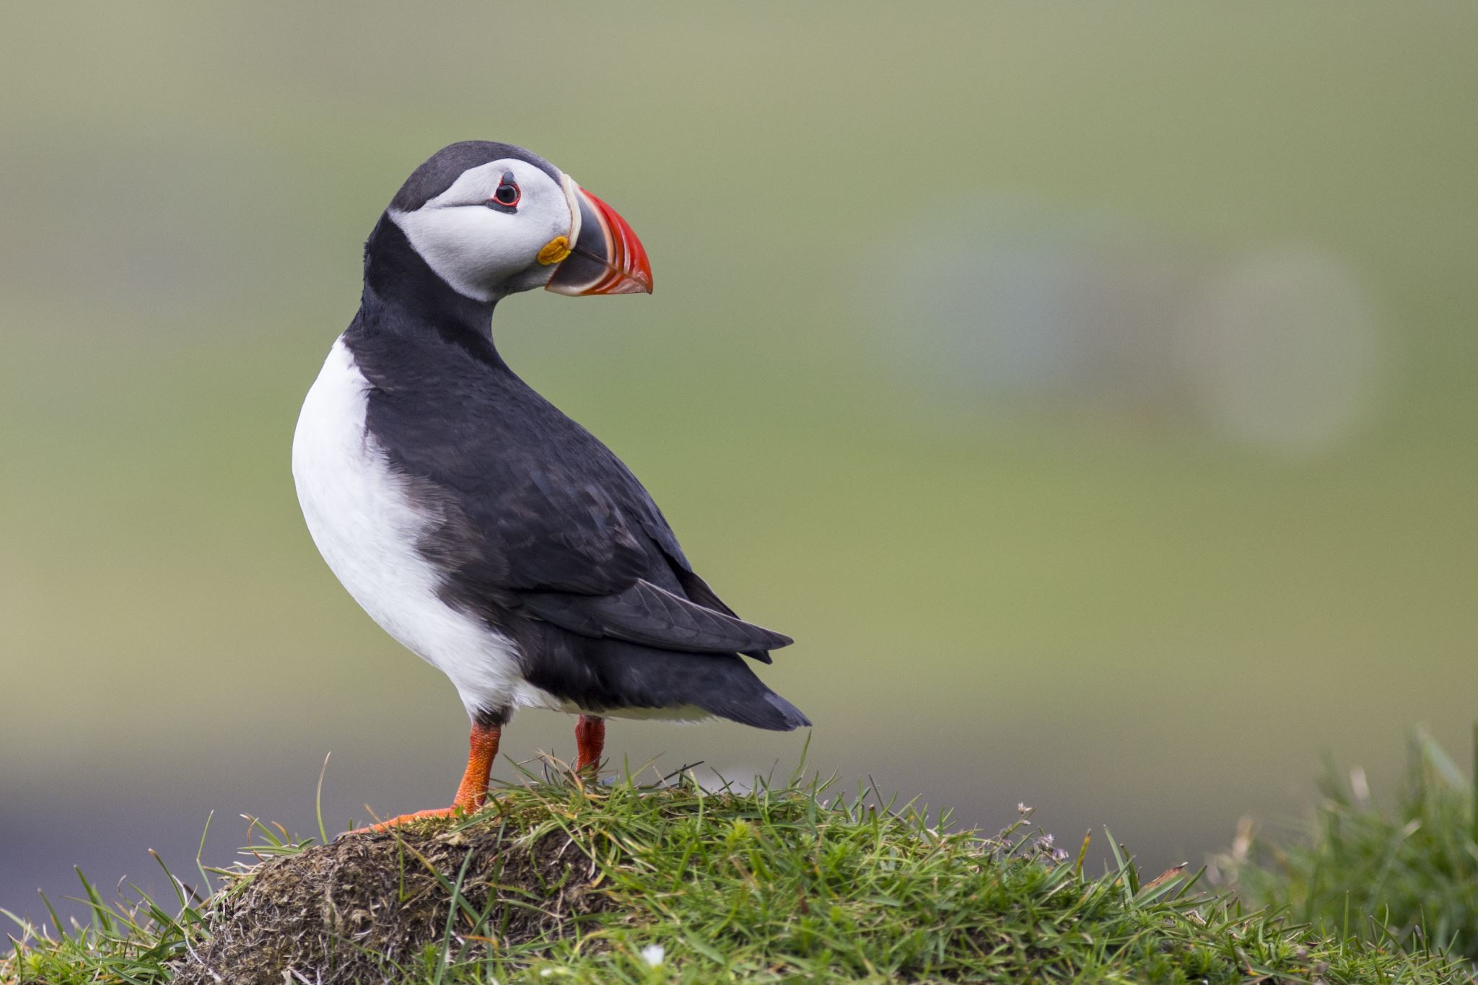

The charity
I chose to support the WWF (World Wide Fund for Nature) because their mission closely aligns with my campaign's message about protecting the environment and restoring balance to nature. WWF works globally to tackle climate change, deforestation, and wildlife loss, the same issues I'm highlighting in my project.

Slide 7
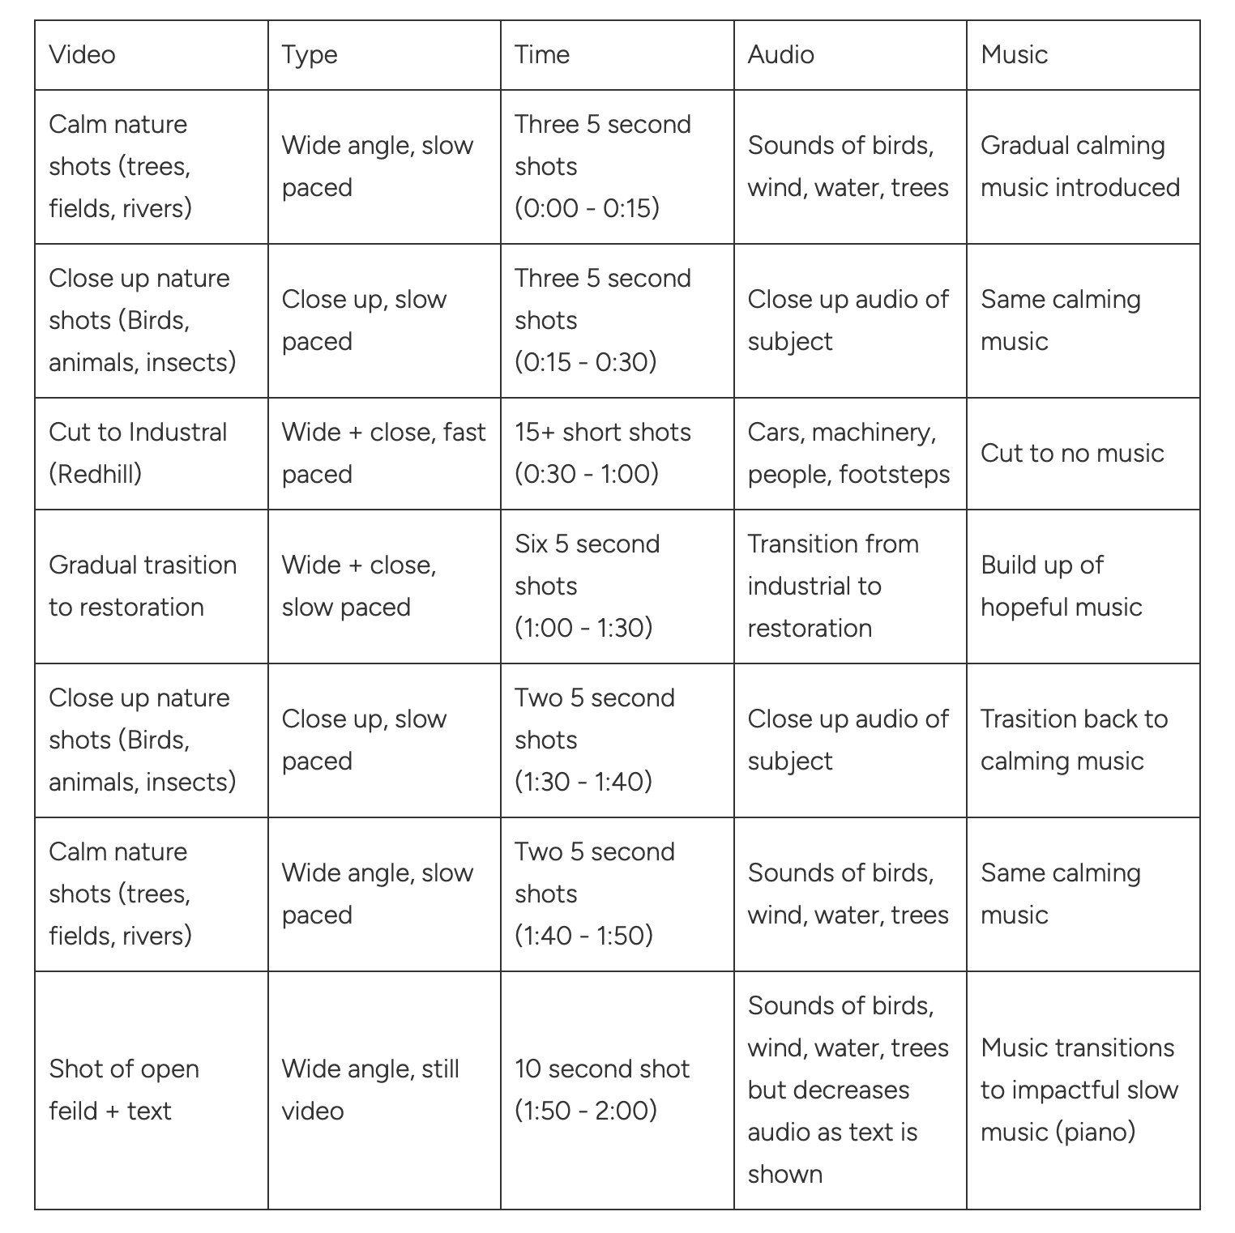
Storyboard
This story board has every component of every shot required for the advert
(Video, Type, Time, Audio, Music)

Slide 8
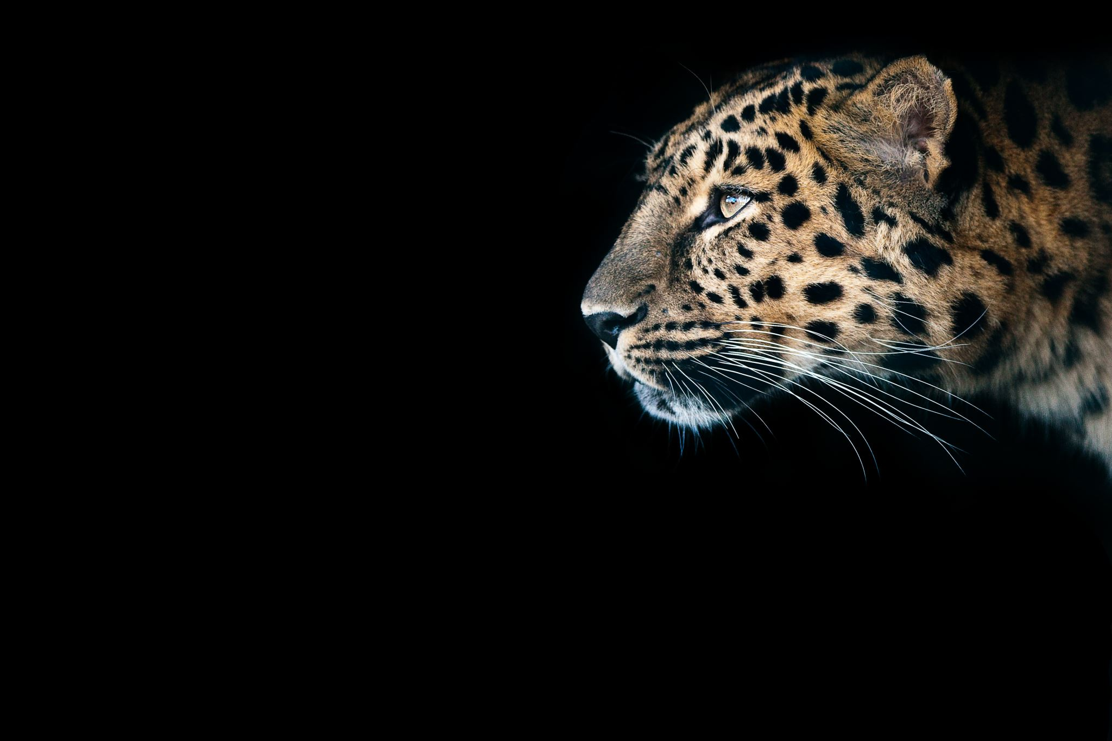
Format & Style
It will be a 2 min long video with a cinematic and emotive style along with contrast warm nature tones with muted industrial tones. The pacing will be slow for the nature shots but fast for the industrial ones.

Slide 9
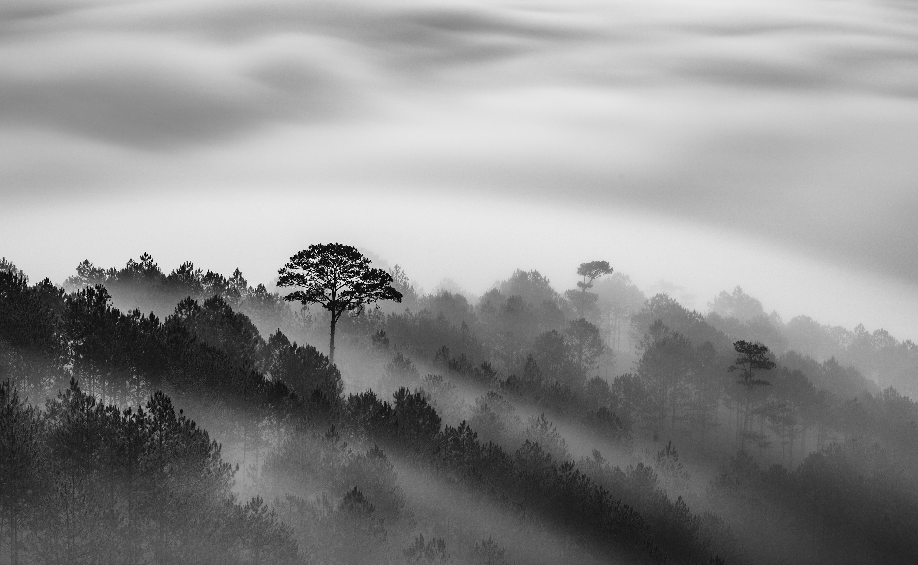
Thank you for watching this presentation

